Slide 1
Machine Learning HW#4
Javier Salazar
1001144647

Slide 2
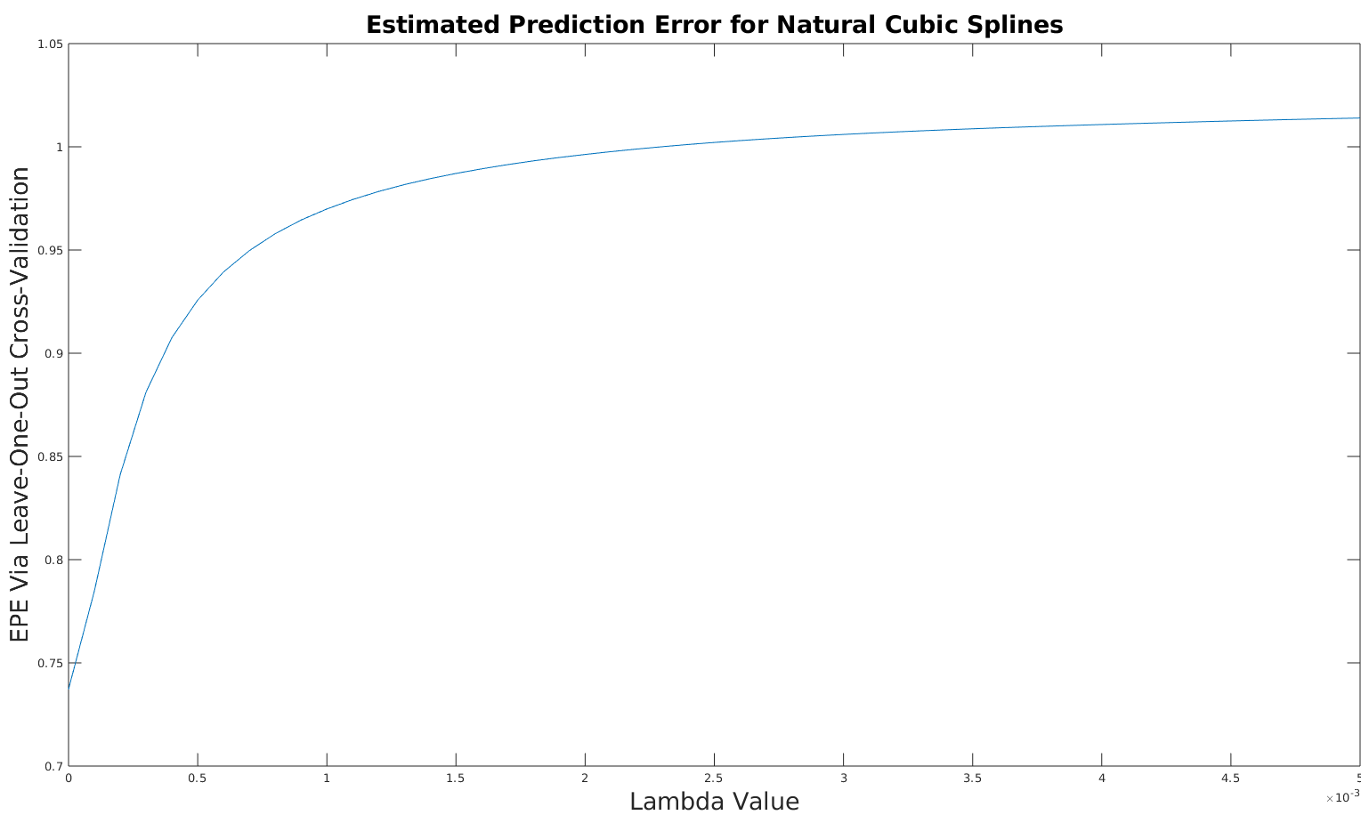
Problem 1 – EPE Results (Knots = 5)

Slide 3
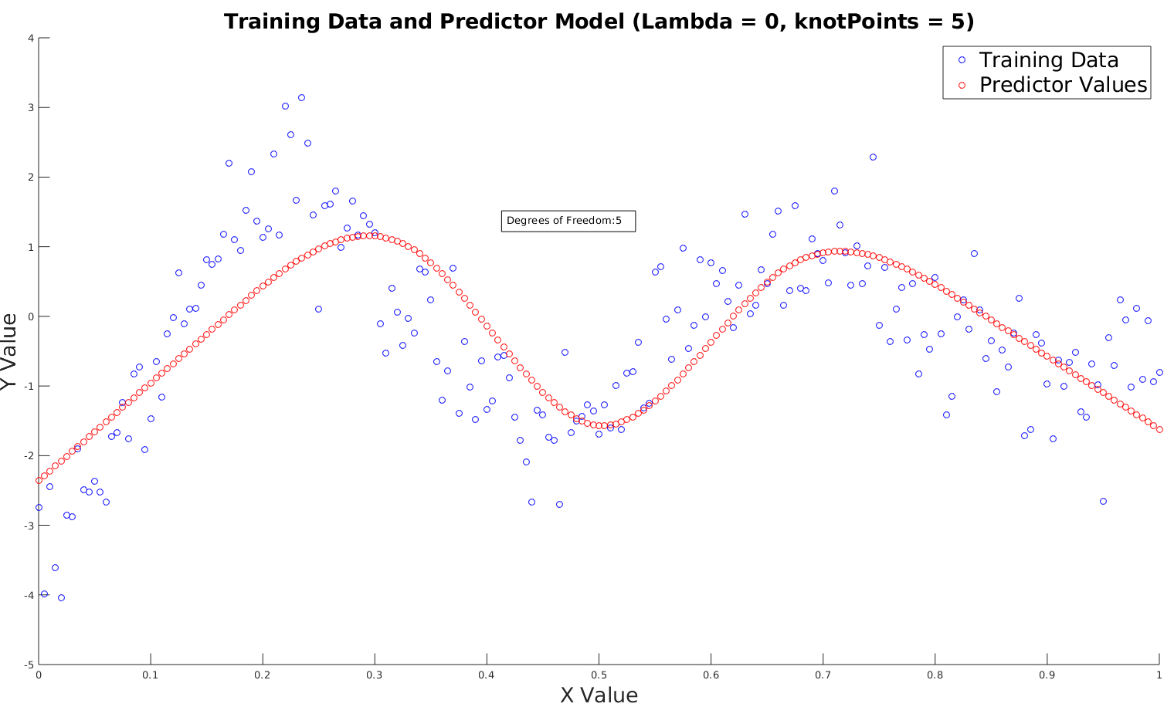
Problem 1 (5 Knot Points)

Slide 4
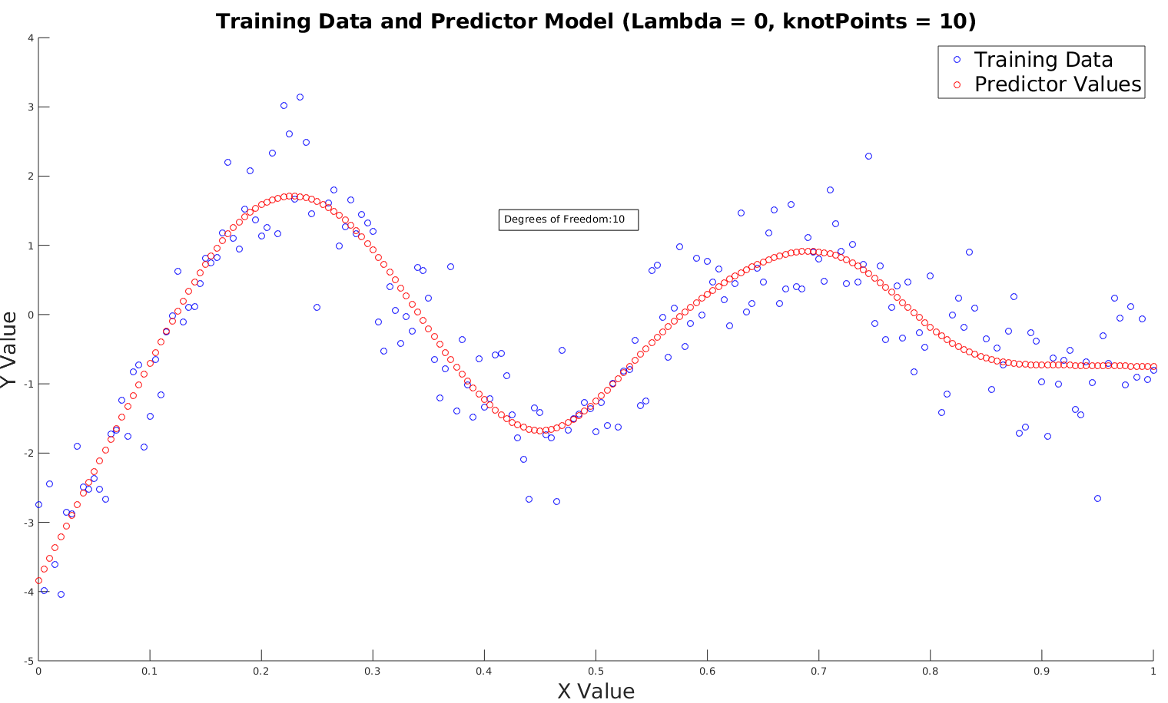
Problem 1 (10 Knot Points)

Slide 5
Problem 1 Analysis
Lambda of 0 for knotPoints = 5 gives lowest EPE
This makes sense since slide 3 shows that knotPoints = 5 is “underfitting” the training data while knotPoints = 10 is “just right”
Therefore, introducing regularization parameter will make the error higher since there is no overfitting with knotPoints = 5
For lowest EPE, we have that the trace of the S matrix is 5 so we have 5 degrees of freedom for lowest EPE (given knotPoints = 5)

Slide 6
Problem 1 Code Description
The ‘nls.m’ file is where the EPE Cross-Validation test is performed with the natural cubic splines algorithm
The ‘cubicCode.m’ file is where the plots of training data vs predictor values are generated
Both files can accept however many knotPoints the user desires as well as the filename of the training file
The trace of the S matrix is calculated and displayed as an annotation in the plots as shown in slide 3 and 4

